Slide 1

ReactOS and the $100 Laptop
Notes:
Title Page

Slide 2
Overview of ReactOS
It’s a Windows Replacement (Licensed under the GPL with parts licensed under X11, BSD, and other GPL compatible licenses)
The goal is to be 100% compatible with Windows
We replicate the Kernel design, Drivers, HAL, etc
We take “innovative routes” of design
- tcpip.sys and friends are the TCP/IP stack from OSkit-Mach/FreeBSD and shoe horned in to a driver
- USB Stack is a port of the Xbox Cromwell Linux USB shoved in to a Windows driver
- Most of the Win32 Subsystem user-mode comes from Wine libraries built as Windows DLLs
Notes:
5 min overview.

Slide 3
General Status
What works
- FreeSoftware Applications: Firefox, OpenOffice, Putty, Abiword and many other Win32 applications work
- Proprietary applications: Office2000, Some Windows Games, Winzip, many more.
- Drivers: ATI, Nvidia (OpenGL), AMD and others load and work
What’s in progress
- Network layer
- True Windows style Plug and Play support
- DirectX and OpenGL
- Sound Support
Notes:
5
5 min overview.

Slide 4
What ReactOS Currently Lacks
Security Subsystem (Skeleton in place)
Printing Subsystem
Network Services (Support exists but Samba and friends need to be ported)
NTFS support
Current driver support is limited to what we write ourselves or what Windows drivers the user is able install
Internationalization and Translations are currently limited to European Languages
Notes:
5 min overview.

Slide 5
How would supporting ReactOS help the $100 laptop project?
Provides support for a large pool of existing applications
Allows for a larger pool of developers to write software for the $100 laptop
Less retraining time and cost to administrators and distributors who are versed in the Windows platform
Notes:
5 min discussion.

Slide 6
How ReactOS and the $100 Laptop Project can work together
Early Access to $100 laptops to ReactOS developers
Shipping the $100 laptop with a copy of ReactOS. (Perhaps just on CD)
Both could help provide support for users who chose to run ReactOS instead of RedHat.
Notes:
5 min overview.

Slide 7
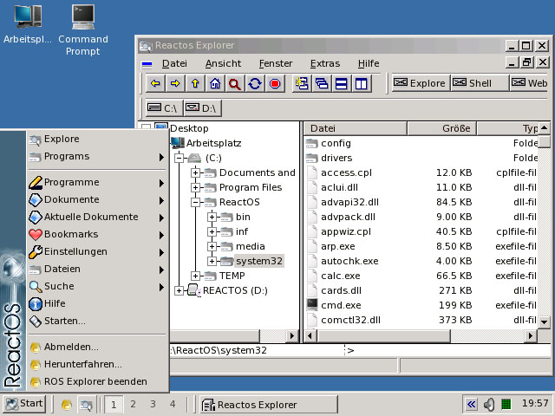
Language Support
Swedish
German
Spanish
Russian
Czech
English
Others
Notes:
1 min discussion on Language Support

Slide 8
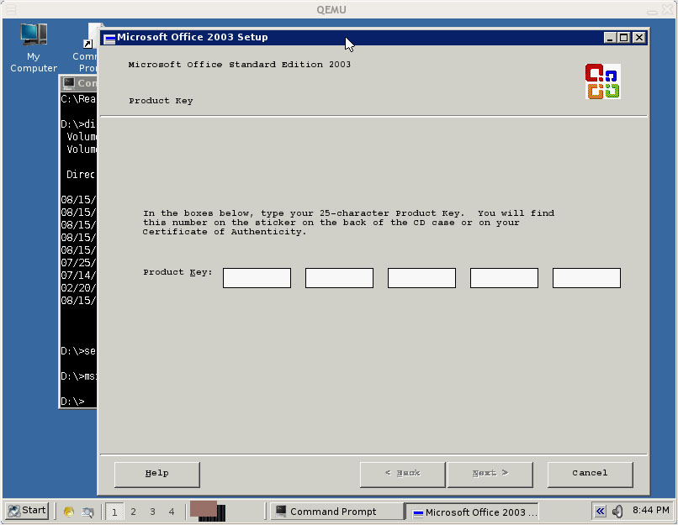

Application Support
Microsoft Office
Firefox
OpenOffice
Infran View
Mirc
Putty
Notes:
1 min discussion on application support

Slide 9
Demo of ReactOS
Question & Answer session
Demo
Question and Answer
Closing statements
Notes:
5 min discussion + 5 min presentation of ReactOS

